Slide 1
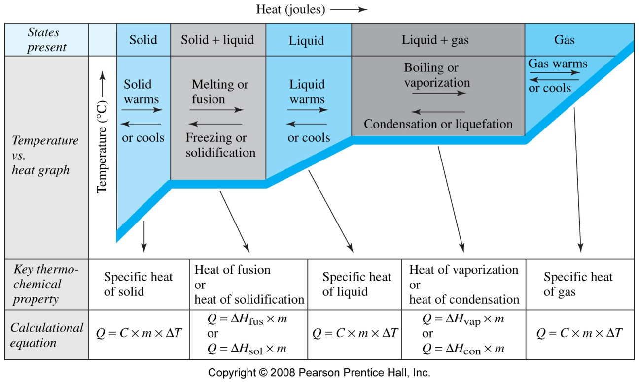
Heating Curve of Water
5
4
3
2
1
(or n)
(or n)
m – mass, g
n – number of moles
ΔH_{fus}
J/g or J/mol
ΔH_{vap}

